Slide 1
Encapsulation and Composition

Slide 2
Learning Objectives
By the end of this lesson, students will be able to:
Define encapsulation and its purpose in OOP.
Distinguish between composition and inheritance.
Apply getter and setter methods to protect data.

Slide 3

What is Encapsulation?
Encapsulation means hiding internal object details and restricting direct access to data.
Achieved by making properties private and using methods to access or modify them.

Slide 4
Encapsulation Principles
Private properties: Prevent direct access to data
Validation and security: Add rules inside methods to protect the data
Loose coupling: Objects only interact through methods, not direct variables

Slide 5
Best Practices in Encapsulation
Always declare properties as private
Use get and set methods to read/write values
Validate data in setter methods
Never expose sensitive data (e.g. passwords) directly

Slide 6
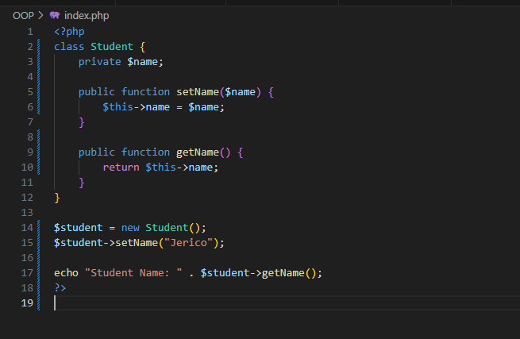
Sample Code
Notes:
HINDI MO SYA PWEDENG I ACCESS OUTSIDE THE CLASS
LIKE
$student1= new Student();
$student1->name; wil be returning error
Prevents direct access to $name
Ensures validation if needed inside setName()

Slide 7
Common Terms
Term | Meaning
private | Only accessible inside the class
public | Accessible from outside the class
get method | Retrieves the value
set method | Assigns/updates the value

Slide 8
Real-World Example of Encapsulation Principles
ATM Machine
-You insert your card and enter your PIN so you can see your Balance
-You don’t see how your account balance is calculated
-You just use a method: Withdraw() or CheckBalance()
➡️ The ATM hides the internal data (account details)
➡️ It only allows access through limited options (buttons/methods)
Notes:
<?php
class BankAccount {
private $balance;
public function __construct($amount) {
$this->balance = $amount;
}
public function deposit($amount) {
if ($amount > 0) {
$this->balance += $amount;
}
}
public function getBalance() {
return $this->balance;
}
}
$account = new BankAccount(1000);
$account->deposit(500);
echo $account->getBalance();
?>

Slide 9
Thank You
Notes:
<?php
class BankAccount {
private $balance;
public function __construct($amount) {
$this->balance = $amount;
}
public function deposit($amount) {
if ($amount > 0) {
$this->balance += $amount;
}
}
public function getBalance() {
return $this->balance;
}
}
$account = new BankAccount(1000);
$account->deposit(500);
echo $account->getBalance();
?>

